Slide 1
INTERIM SLIDE DECK
Introduction
This interim solution explains the exploratory data analysis on
Seasonality
Correlation between sales and customer column
Effect of promo on sales and customers

Slide 2
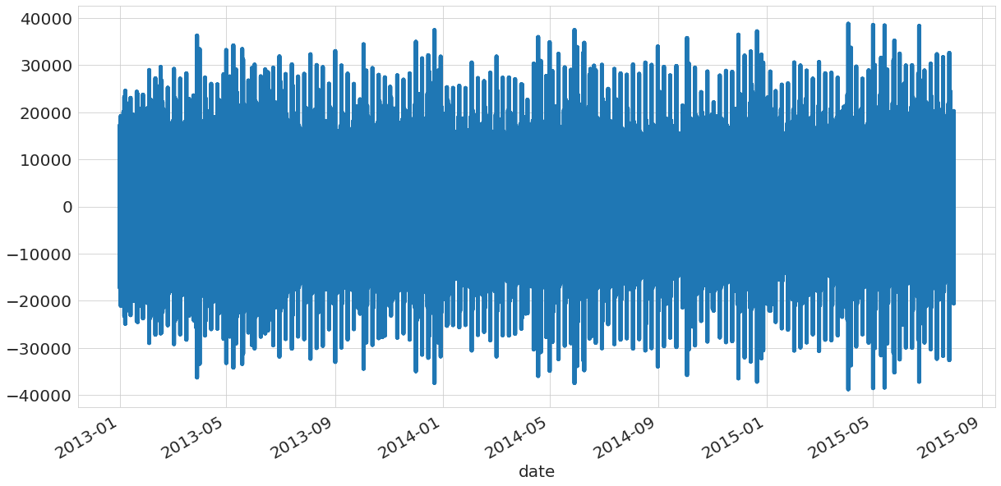
Seasonality
As you can see Sales fluctuate over time and is at peak at the 5 month of each year.

Slide 3
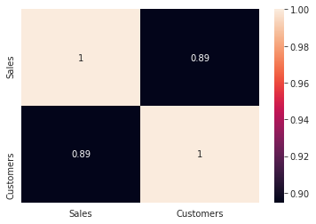
Sales /customer correlation
As you can see ,Sales and customers are highly correlated with a positive value 0f 0.89 .Meaning for sales to be high,customers have to buy the Rossmann Pharmaceutical products.

Slide 4
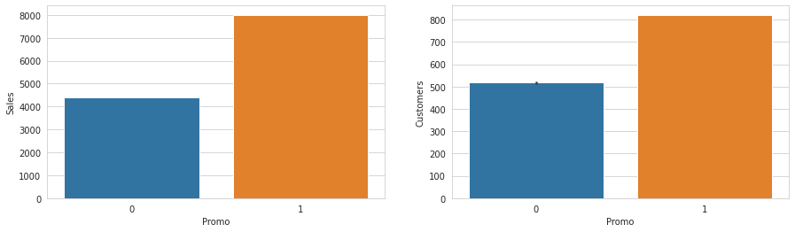
Effect of promotion on Sales
As you can see the promos affect sales and customers.Promos attract more customers hence boost sales making sales increase.
How does it affect already existing customers?
It makes the number of customers increase.

